Slide 1
Find Your Technician
Akhilesh Gattu (13)
Nagi Reddy Sollapuram (53)
Rahul Ramini (50)
Sree Ravi Kishore Lellapalli (23)

Slide 2
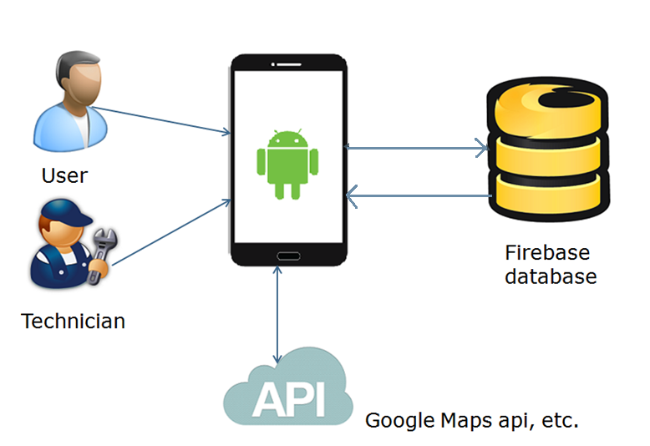
System Architecture

Slide 3
Features
● User Registration
● User Login & User Logout
● Location based search
● Cost Estimation
● User can provide Feedback
●Forgot password
● Technician Registration

